Slide 1
Coordinate system

Slide 2
Three types of coordinate systems
Coordinate systems are the most important concept in a CAD system. They are used to input, store, and display geometric model. There are three kinds of coordinate systems, that is
Model coordinate system (MCS)
Working coordinate system (WCS)
Screen coordinate system (SCS)

Slide 3
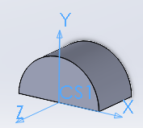
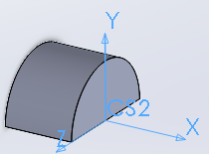
Model Coordinate System (MCS)
MCS is a 3D Cartesian coordinate system used by most of CAD softwares to perform internal geometrical data operations, such as record, storage and calculation.
MCS is the only coordinate system CAD software can identify. Even users define another type of coordinate system during the process of creating models, the model will still be convert to data under MCS to store.
Sometime MCS is also called Absolute Coordinate System(ACS).

Slide 4
Working Coordinate System(WCS)
A modelling processing of a 3D body is usually a result of combining many steps of creating some simple structure bodies. WCS is an user defined local coordinate system, with which user can generate some basic structures easily.
WCS has different appearances in different CAD systems. One of the most useful one is a sketch plane.
As we mentioned, whatever was chosen to be a coordinate system , the stored data should be represented with MCS. To satisfy this requirement, a homogenous transform matrix will play an very important role.

Slide 5
Working Coordinate System(WCS)
Given a vector under WCS, , and let is the stored point represented with MCS. Supposing T is the transformation matrix, we have

Slide 6
Homogenous transformation matrix
Since we still need consider translation and project operation meanwhile. The matrix to finish all the transformations from WCS to MCS looks like as follows.

Slide 7
Homogenous transformation matrix
Let
The above matrix become
T is to transform coordinate components, o means origin point shifting,
p is perspective vector, s means perspective shifting

Slide 8
Homogenous transformation matrix
Actually, for any point under WCS should be transformed to MCS, the final forms looks like

Slide 9
Some useful HT matrices
Matrix without perspective involved

Slide 10
Some useful HT matrices
Matrix pure shearing involved
At the same time, T part of this matrix is symmetric. Which means t₂₁=t₁₂, t₃₁=t₁₃, t₃₂=t₂₃

Slide 11
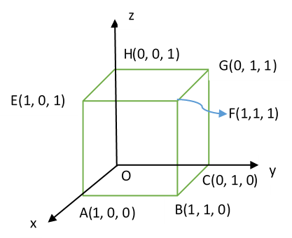
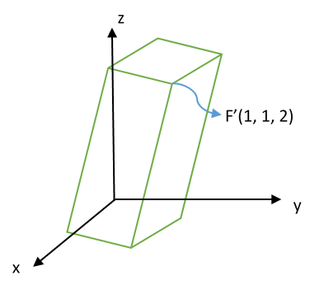
Example: Given a cube with length of edge 1 at the origin O, assume vertex O is fixed, and there is a homogenous transformation which shear vertex F(1,1,1) to F’(1,1,2). Find out the transformation matrix and the new positions of all vertices.

Slide 12
To vertex E, we have the linear equations after taking use of shearing transformation
The solution of homogenous transformation matrix is

Slide 13
Screen coordinate system (SCS)
The coordinate system of screen is a 2D Cartesian coordinate system, which origin (0,0) locates at left-upper corner of the screen. The scale of SCS usually depends on the resolution of screen. For example if the revolution of a screen is 1096x1024, which means the X axis extend to right of screen until scale of 1096, and the Y axis extend to bottom of screen until scale of 1024.
The SCS is mainly used to display correct images on screen device. So it is pixel related.
(0,0)
X
Y

Slide 14
Some tips
By default, in most of CAD software, the WCS and MCS are overlapped as you start up the main program.
Definitely, To display correct image of the cad model on screen, we still need some transformation operations to make it sense.
From the view of user, whose input geometrical elements will firstly transform to uniforms representations under MCS, then through display converting package developed by CAD software provider, all 3D geometrical items will be shown on the 2D screen.

